Slide 1
Software Testing
Testing Activities
Presented By
Ning Chen, Ph.D.
Professor
Department of Computer
Science
California State University,
Fullerton
© Ning Chen, 2017
*

Slide 2
Module Objectives
This module focuses on understanding testing activities

Slide 3
A Well-Known Test Example
Weinberg-Myers Triangle Problem
  The problem is simple - you have three inputs for sides of a triangle, and the computer will tell you if the values you entered are scalene, isosceles, equilateral, or not-a-triangle.

Slide 4
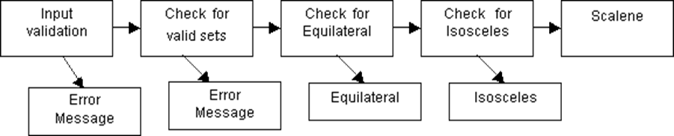
Flowchart Approach

Slide 5
Heuristic Approach
Tests Inputs Expected Results
Any element of an input set is negative (-1,1,1), (1,-1,1), (1,1,-1) Error Message
Any element of an input set is zero (0,1,1), (1,0,1), (1,1,0), (1,0,0), (0,1,0), (0,0,1), (0,0,0) Error Message
Any element of an input set is greater than 9 (10,1,1), (1,11,1), (1,1,12) (15,15,15) Error Message
Any element of an input set is an alphabetic letter (T,1,1), (1,T,1), (1,5,T) Error Message
Any element of an input set is a character symbol (:,1,3), (5,., 8), (2,4,/) Error Message
There are less than three elements of the input set (1,2) Error Message
There are more than three elements of the input set (2,4,5,8) Error Message
Any element of an input set is a combination of any of the invalid inputs (1A, 3,4), (4,/W",8) (2,4,:) Error Message
The sum of two numbers equals the third in any of three permutations a+b=c, a+c=b, b+c=a (2,4,6), (4,9,5), (8,4,4) Error Message
The sum of two numbers is less than the third in any of three permutations a+b (3,3,8), (2,5,1), (7,3,3) Error Message
If all three digits of a valid input are the same the program displays that it has recognized an "equilateral" triangle (5,5,5) Equilateral !
If any two of the digits of a valid input are the same the program displays that it has recognized an "isosceles" triangle (3,3,4),(7,8,7),(5,6,6) Isosceles !
If each digit of a valid input is different the program displays that it has recognized a "scalene" triangle. (3,4,5), (3,5,4), (5,4,3) Scalene !

Slide 6
Other Examples
We have a routine that converts “foo” to “FOO” (get its upper case).
We have a second routine that tells us whether “FOO” is upper case.
We have a third routine that splits a given string (“hello world” to “hello” and “world”)

Slide 7
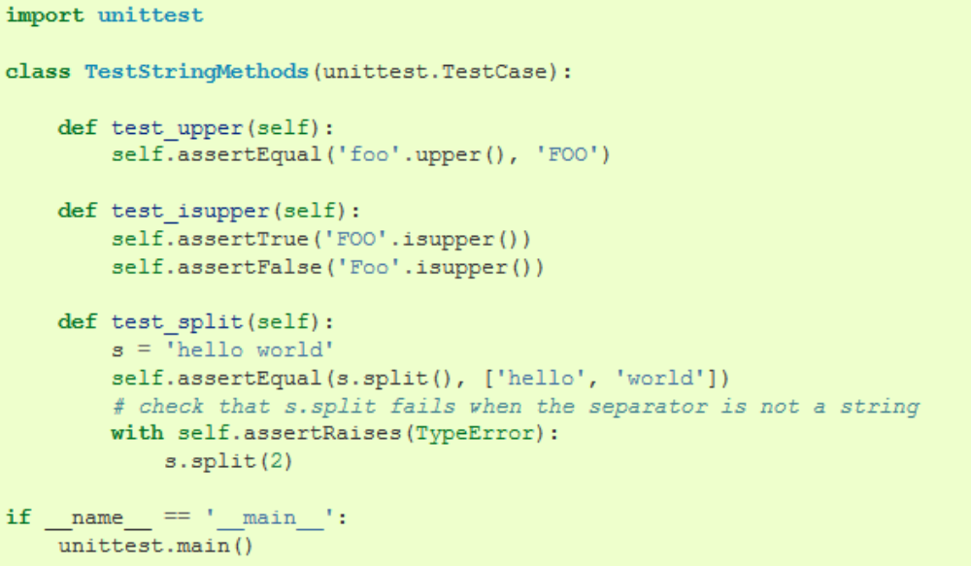
Test Framework Approach
Python example (say, mytestcases.py):

Slide 8
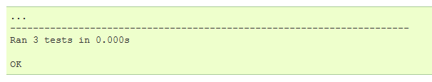
Test Framework Approach
If you run it ($python ./mytestcases.py), you get:

Slide 9
PyUnit
The Python unit testing framework, sometimes referred to as “PyUnit,” is a Python language version of JUnit, by Kent Beck and Erich Gamma. JUnit is, in turn, a Java version of Kent’s Smalltalk testing framework. Each is the de facto standard unit testing framework for its respective language.

Slide 10
PyUnit
unittest supports test automation, sharing of setup and shutdown code for tests, aggregation of tests into collections, and independence of the tests from the reporting framework. The unittest module provides classes that make it easy to support these qualities for a set of tests.

Slide 11
PyUnit
PyUnit (unittest) supports some important concepts:
test fixture
  A test fixture represents the preparation needed to perform one or more tests, and any associate cleanup actions. This may involve, for example, creating temporary or proxy databases, directories, or starting a server process.
test case
  A test case is the smallest unit of testing. It checks for a specific response to a particular set of inputs. unittest provides a base class, TestCase, which may be used to create new test cases.
test suite
  A test suite is a collection of test cases, test suites, or both. It is used to aggregate tests that should be executed together.
test runner
  A test runner is a component which orchestrates the execution of tests and provides the outcome to the user. The runner may use a graphical interface, a textual interface, or return a special value to indicate the results of executing the tests.

